Slide 1
Chapter 3
Program Control Statements
李晔锋

Slide 2
Key Skills & Concepts
Input characters from the keyboard
Know the complete form of the if statement
Use the switch statement
Know the complete form of the for loop
Use the while loop
Use the do-while loop
Use break to exit a loop
Use break as a form of goto
Apply continue
Nest loops

Slide 3
Input Characters from the Keyboard
public class KbIn {
public static void main(String[] args) throws java.io.IOException {
// TODO Auto-generated method stub
char ch;
System.out.print("Press a key followed by Enter: ");
ch = (char)System.in.read();
System.out.println("Your key is: " + ch);
}
}

Slide 4
The if Statement
The complete form of if statement
if(condition) statement
else statement
if(condition)
{
statement sequence
}
else
{
statement sequence
}

Slide 5
public class Guess2 {
public static void main(String[] args) throws java.io.IOException{
// TODO Auto-generated method stub
char ch, answer = 'K’;
System.out.println("I'm thinking of a letter between A and Z");
System.out.print("Can you guess it: ");
ch = (char)System.in.read();
if(ch == answer) System.out.println("** Right **");
else System.out.println("...Sorry, you're wrong.");
}
}

Slide 6
Nested ifs
if(sex == ‘男’){
if(money > 5000)
if(height>180) …
else …
else
…
}
else
{
if(weight<110) …
else …
}

Slide 7
Nested if Example
public class Guess3 {
public static void main(String[] args) throws java.io.IOException {
// TODO Auto-generated method stub
char ch, answer = 'K’;
System.out.println("I'm thinking of a letter between A and Z");
System.out.print("Can you guess it: ");
ch = (char)System.in.read();
if(ch == answer) System.out.println("** Right **");
else { System.out.print("...Sorry, you're ");
if(ch < answer) System.out.println("too low.");
else System.out.println("too high.");
}
}
}

Slide 8
The if-else-if Ladder
if(condition)
statement;
else if(condition)
statement;
else if(condition)
statement;
…
else
statement;

Slide 9
The if-else-if Ladder
public class Ladder {
public static void main(String[] args) {
// TODO Auto-generated method stub
int x;
for(x = 0; x < 6; x++) {
if(x == 1)
System.out.println("x is one");
else if(x == 2)
System.out.println("x is two");
else if(x == 3)
System.out.println("x is three");
else if(x == 4)
System.out.println("x is four");
else
System.out.println("x is not between 1 and 4");
}
}
}

Slide 10
The switch Statement
switch(expression){
case constant1:
statement sequence
break;
case constant2:
statement sequence
break;
…
default:
statement sequence
}

Slide 11
The switch Statement
Each value specified in the case statements must be a unique constant expression (such as a literal value). Duplicate case values are not allowed. The type of each value must be compatible with the type of expression.
The default statement sequence is executed if no case constant matches the expression. The default is optional; if it is not present, no action takes place if all matches fail. When a match is found, the statements associated with that case are executed until the break is encountered or, in the case of default or the last case, until the end of the switch is reached.

Slide 12
The switch Demo without break
public class NoBreak {
public static void main(String[] args) {
// TODO Auto-generated method stub
Scanner sc = new Scanner(System.in);
int i = sc.nextInt();
switch(i) {
case 0: System.out.println("i is less than one");
case 1: System.out.println("i is less than two");
case 2: System.out.println("i is less than three");
case 3: System.out.println("i is less than four");
case 4: System.out.println("i is less than five");
}
sc.close();
}
}

Slide 13
Nested switch Statements
It is possible to have a switch as part of the statement sequence of an outer switch. This is called a nested switch. Even if the case constants of the inner and outer switch contain common values, no conflicts will arise.

Slide 14
The for Loop
The complete form of the for loop
for(initialization; condition; iteration) statement
for(initialization; condition; iteration)
{
statement
}

Slide 15
The for Loop Demo
public class SqrRoot {
public static void main(String[] args) {
// TODO Auto-generated method stub
double num, sroot, rerr;
for(num = 1.0; num < 100.0; num++) {
sroot = Math.sqrt(num);
System.out.println("Square root of " + num + " is " + sroot);
//compute rounding error
rerr = num - sroot * sroot;
System.out.println("Rounding error is " + rerr);
System.out.println();
}
}
}

Slide 16
Some Variations on the for Loop
int i, j;
for(i = 0, j = 10; i < j; i++, j--){
System.out.println("i and j: " + i + " " + j);
}
int i;
System.out.println("Press S to stop.");
for(i = 0; (char)System.in.read() != 'S'; i++)
System.out.println("Pass #" + i);

Slide 17
Missing Pieces
int i;
for(i = 0; i < 10;) {
System.out.println("Pass #" + i);
i++;
}
int i = 0;
for(; i < 10;) {
System.out.println("Pass #" + i);
i++;
}

Slide 18
The Infinite Loop
for(;;)
{
//…
}

Slide 19
Loops with No Body
public class Empty3 {
public static void main(String[] args) {
// TODO Auto-generated method stub
int i;
int sum = 0;
//sum the numbers through 5
for(i = 1; i <= 5; sum += i++) ;
System.out.println("Sum is " + sum);
}
}

Slide 20
Declaring Loop Control Variables Inside the for Loop
public class ForVar {
public static void main(String[] args) {
// TODO Auto-generated method stub
int sum = 0;
int fact = 1;
//compute the factorial of the numbers through 5
for(int i = 1; i <= 5; i++) {
sum += i; //i is known throughout the loop
fact *= i;
}
//but , i is not known here
System.out.println("Sum is " + sum);
System.out.println("Factorial is " + fact);
}
}

Slide 21
The while Loop
The general form of the while loop is
while(condition) statement;
while(condition){
statement sequence
}

Slide 22
The while Demo
public class WhileDemo {
public static void main(String[] args) {
// TODO Auto-generated method stub
char ch;
//print the alphabet using a while loop
ch = 'a’;
while(ch <= 'z') {
System.out.println(ch);
ch++;
}
}
}

Slide 23
The do-while Loop
The general form of do-while loop is:
do{
statements
}while(condition);

Slide 24
The do-while Demo
public class DWDemo {
public static void main(String[] args) throws java.io.IOException {
// TODO Auto-generated method stub
char ch;
do {
System.out.print("Press a key followed by ENTER: ");
ch = (char)System.in.read();
}while(ch != 'q’);
}
}

Slide 25
Use break to Exit a Loop
When a break statement is encountered inside a loop, the loop is terminated earlier and program control resumes at the next statement following the loop.
public class BreakDemo {
public static void main(String[] args) {
// TODO Auto-generated method stub
int num = 100;
//loop while i-squared is less than num
for(int i = 0; i < num; i++) {
if(i*i >= num) break; //terminate loop
System.out.print(i + " ");
}
System.out.
}
}

Slide 26
Use break to exit an infinitive loop
public class Break2 {
public static void main(String[] args) throws java.io.IOException {
// TODO Auto-generated method stub
char ch;
for(;;) {
ch = (char)System.in.read(); //get a char
if(ch == 'q') break;
}
System.out.println("You pressed q!");
}
}

Slide 27
Use break to exit a nested loop
public class Break3 {
public static void main(String[] args) {
// TODO Auto-generated method stub
for(int i = 0; i < 3; i++) {
System.out.println("Outer loop count: " + i);
System.out.print(" Inner loop count: ");
int t = 0;
while(t < 100) {
if(t == 10) break; //terminate loop if t is 10
System.out.print(t + " ");
t++;
}
System.out.println();
}
System.out.println("Loops complete.");
}
}

Slide 28
Use break as a Form of goto
Sometimes, a label is used to identify a code block.
When “break label” is used, control is transferred out of the named block of code.
The labeled block of code must enclose the break statement, but it does not need to be the immediately enclosing block.

Slide 29
public class Break4 {
public static void main(String[] args) {
// TODO Auto-generated method stub
int i;
for(i = 1; i < 4; i++) {
one: {
two: {
three: {
System.out.println("\ni is " + i);
if(i == 1) break one;
if(i == 2) break two;
if(i == 3) break three;
//this is never reached
System.out.println("won't print");
}
System.out.println("After block three.");
}
System.out.println("After block two.");
}
System.out.println("After block one.");
}
System.out.println("After for.");
}
}

Slide 30
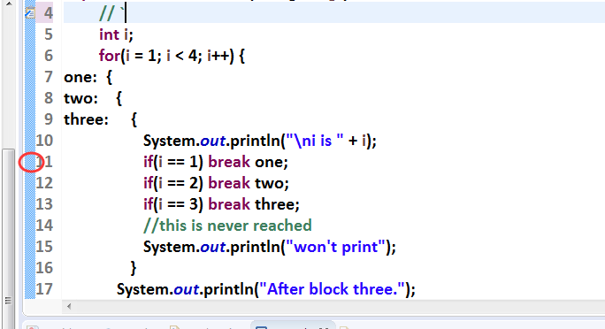
Use Eclipse to Trace and Debug the Code
First, right click the blue part where the line of code you want the debug on.

Slide 31
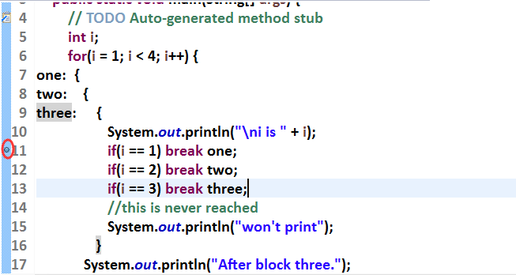
Use Eclipse to Trace and Debug the Code
A break point will be created with the form of a small blue dot.

Slide 32
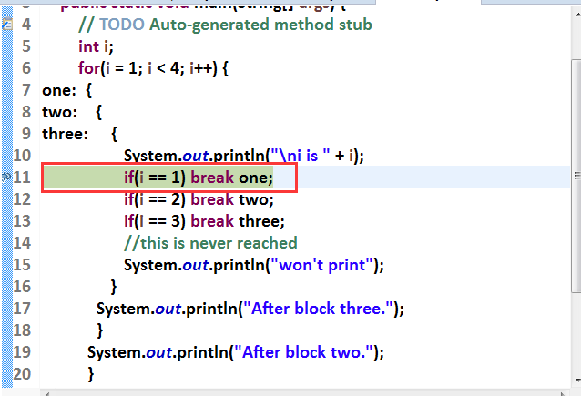
Use Eclipse to Trace and Debug the Code
Right click on the main class of the project, select “Debug as”→ “Java Application”. A dialog will prompt to open the debug perspective, click “switch” to change the perspective.
Then you will find the code stops at the break-pointed line.

Slide 33
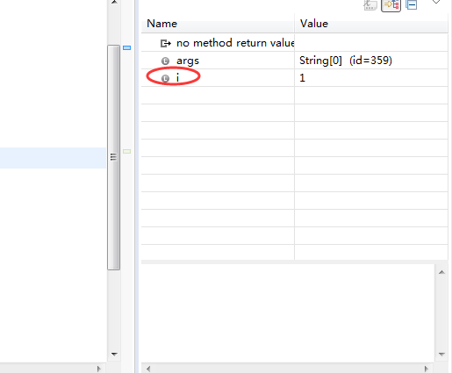
Use Eclipse to Trace and Debug the Code
At the right side, you will see the values of current variables.

Slide 34

Use Eclipse to Trace and Debug the Code
There are very useful buttons at the menu bar for debugging.
Step into: Proceed on one more line and step into a method if necessary.
Step over: Proceed on one more line without stepping into a method.

Slide 35
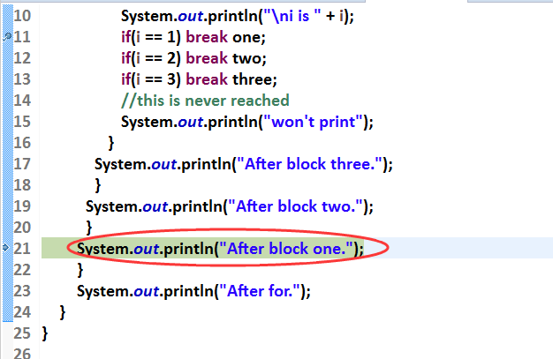
Use Eclipse to Trace and Debug the Code
Click “step over”, you’ll find that the cursor moves to the end of “block one”.

Slide 36
Use Eclipse to Trace and Debug the Code
You can stop debugging by clicking the red square.
You can also remove the break point,
Go back to Java perspective by clicking “Window” → “Open perspective” → “Java”

Slide 37
Use break as a Form of goto
Note: You cannot use break to transfer control to a block of code that does not enclose the break statement.

Slide 38
Use continue
The continue statement forces the next iteration of the loop to take place earlier, skipping any code between itself and the conditional express that controls the loop.
public class ContDemo {
public static void main(String[] args) {
// TODO Auto-generated method stub
int i;
//print even numbers between 0 and 100
for(i = 0; i <= 100; i++) {
if((i%2) != 0) continue; //iterate
System.out.println(i);
}
}
}

Slide 39
Use continue with a label
The continue statement may specify a label to describe which enclosing loop the continue.
public class ContToLabel {
public static void main(String[] args) {
// TODO Auto-generated method stub
outerloop:
for(int i = 1; i < 10; i++) {
System.out.print("\nOuter loop pass " + i +
", Inner loop: ");
for(int j = 1; j < 10; j++) {
if(j == 5) continue outerloop;
System.out.print(j + " ");
}
}
}
}

